Slide 1
Ch.5 Continuous Probability Distributions(연속확률분포)
Updated: November 8, 2016
Choi, Kwanghoon
Dept. of Electronics and Computer Engineering
Chonnam National University

Slide 2
This Lecture
Continuous Probability Distributions (연속확률분포)
Continuous uniform distribution(5.1 연속균등분포)
Exponential distribution(5.2 지수 분포)
Gamma distribution(5.2 감마분포)
Normal distribution(5.3 정규분포)
Chi-squared distribution(5.4 카이제곱분포)
t-distribution(5.4 t-분포)
F-distribution(5.4 F-분포)
Log-normal distribution(5.4 로그정규분포)
Bivariate normal distribution(5.4 이변량정규분포)

Slide 3
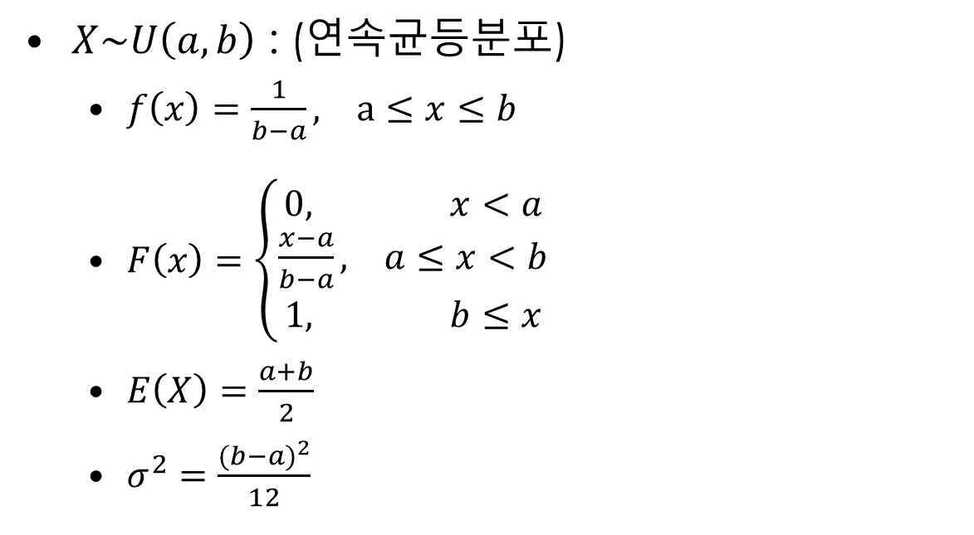
5.1 Continuous Uniform Distribution
$X\sim U\left(a,b\right)$ : (연속균등분포)
$f\left(x\right)=\frac{1}{b−a}, a≤x≤b$
$F\left(x\right)=\left\{\begin{aligned}0, x<a \\ \frac{x−a}{b−a}, a≤x<b \\ 1, b≤x\end{aligned}\right.$
$E\left(X\right)=\frac{a+b}{2}$
$σ^{2}=\frac{{(b−a)}^{2}}{12}$

Slide 4
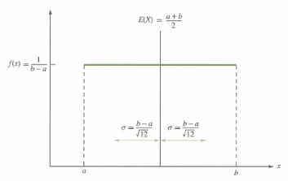
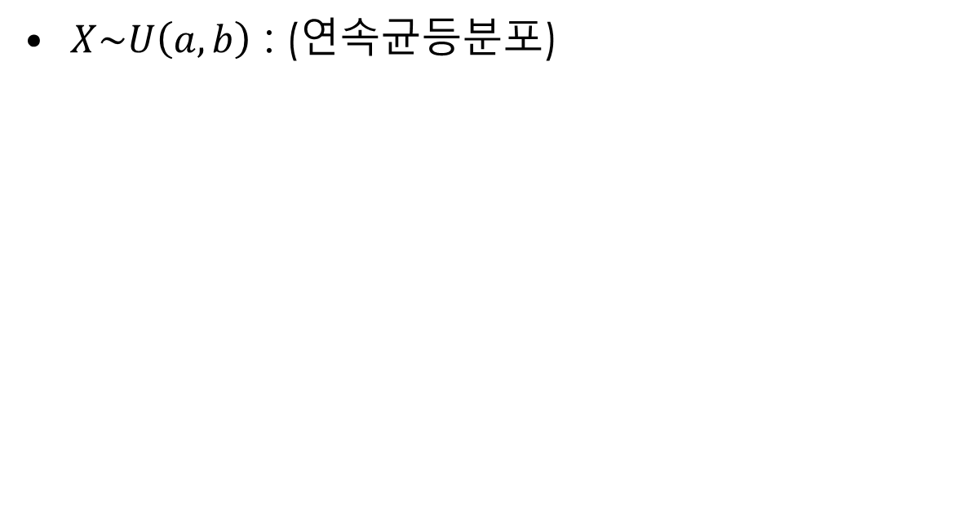
5.1 Continuous Uniform Distribution
$X\sim U\left(a,b\right)$ : (연속균등분포)

Slide 5
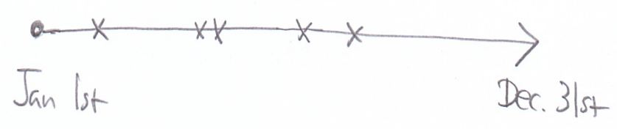
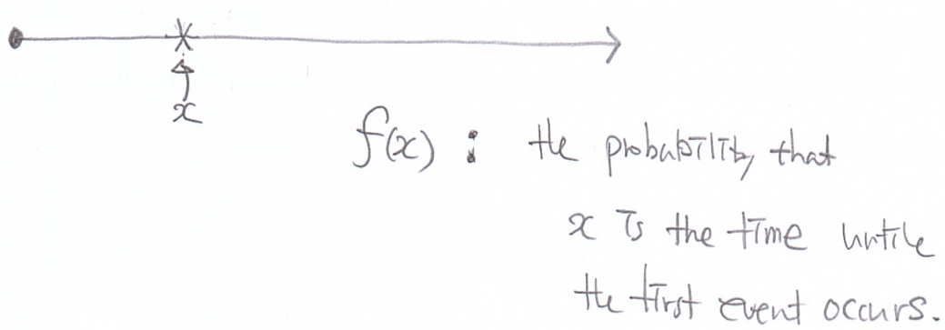
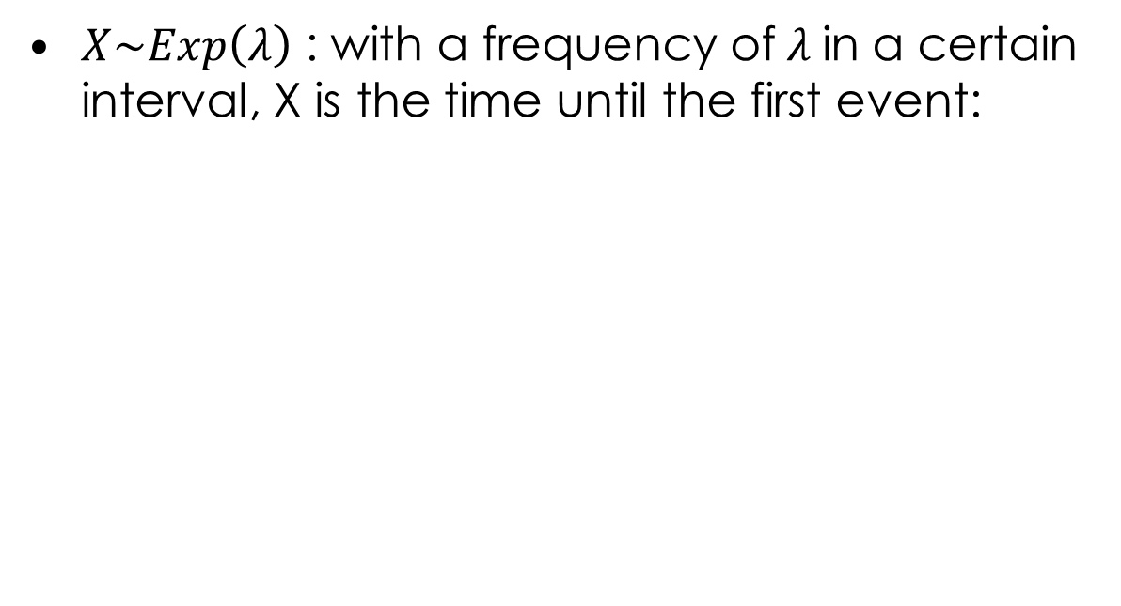
5.2 Exponential Distribution(지수분포)
$X\sim Exp\left(λ\right)$ : with a frequency of$λ$in a certain interval, X is the time until the first event:

Slide 6
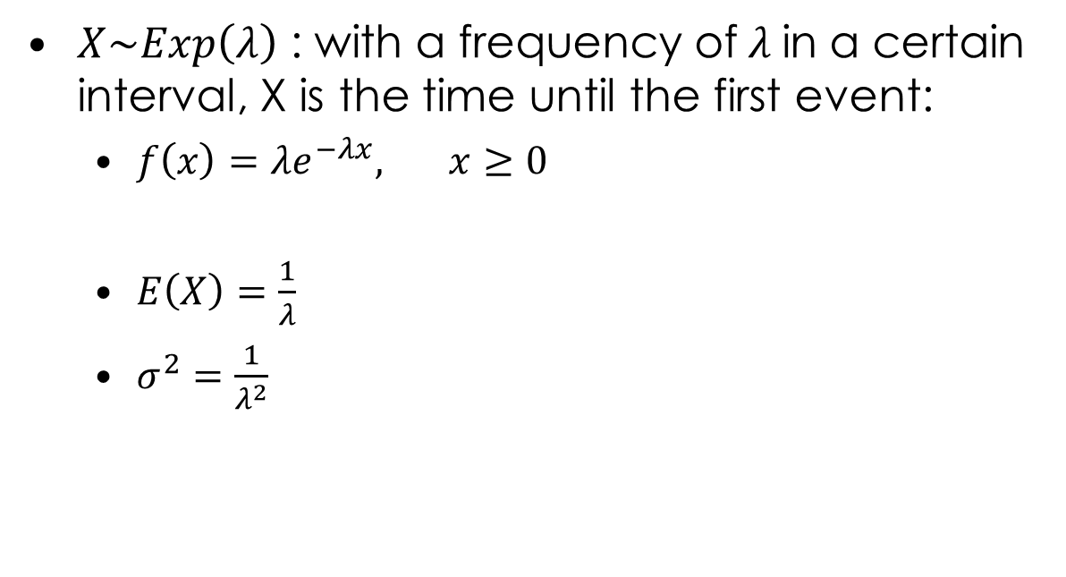
5.2 Exponential Distribution(지수분포)
$X\sim Exp\left(λ\right)$ : with a frequency of$λ$in a certain interval, X is the time until the first event:
$f\left(x\right)=λe^{−λx}, x≥0$
$E\left(X\right)=\frac{1}{λ}$
$σ^{2}=\frac{1}{λ^{2}}$

Slide 7
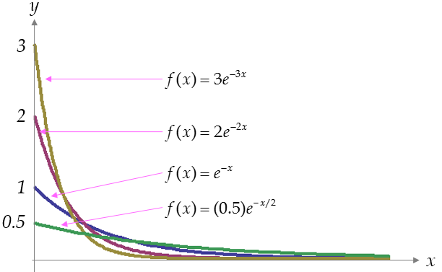
5.2 Exponential Distribution(지수분포)
f(x) over different lambdas

Slide 8
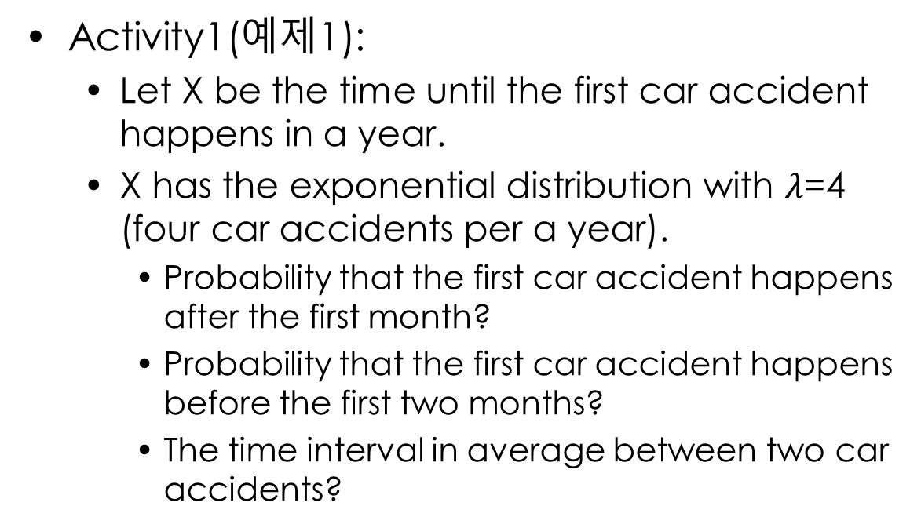
5.2 Exponential Distribution(지수분포)
Activity1(예제1):
Let X be the time until the first car accident happens in a year.
X has the exponential distribution with $λ$=4 (four car accidents per a year).
Probability that the first car accident happens after the first month?
Probability that the first car accident happens before the first two months?
The time interval in average between two car accidents?

Slide 9
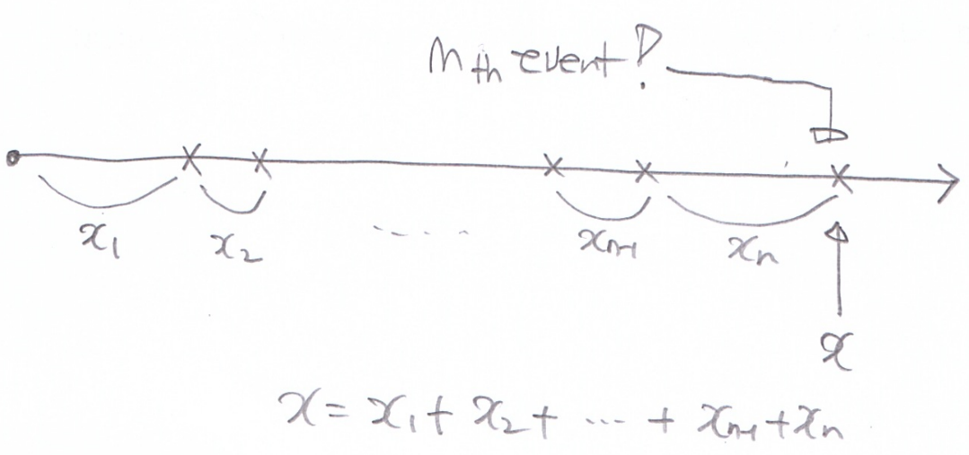
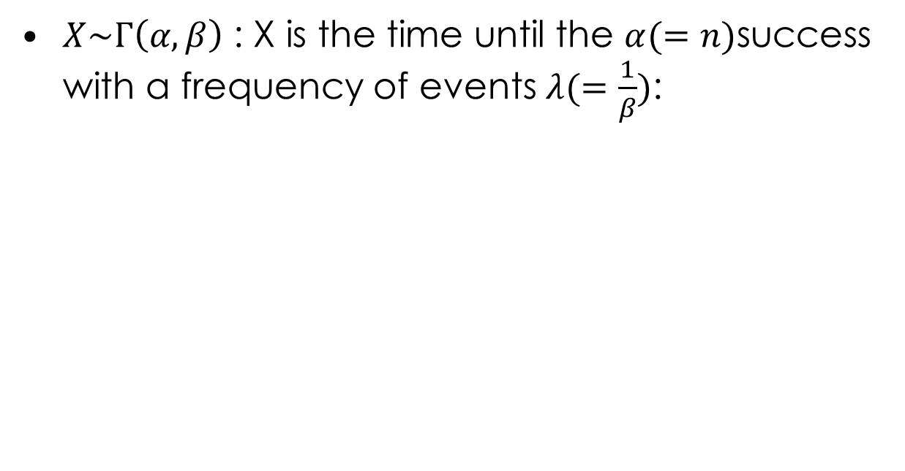
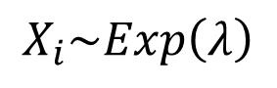
5.2 Gamma Distribution(감마분포)
$X\sim Γ\left(α,β\right)$ : X is the time until the $α(=n)$success with a frequency of events $λ(=\frac{1}{β})$:
$$X_{i}\sim Exp\left(λ\right)$$

Slide 10
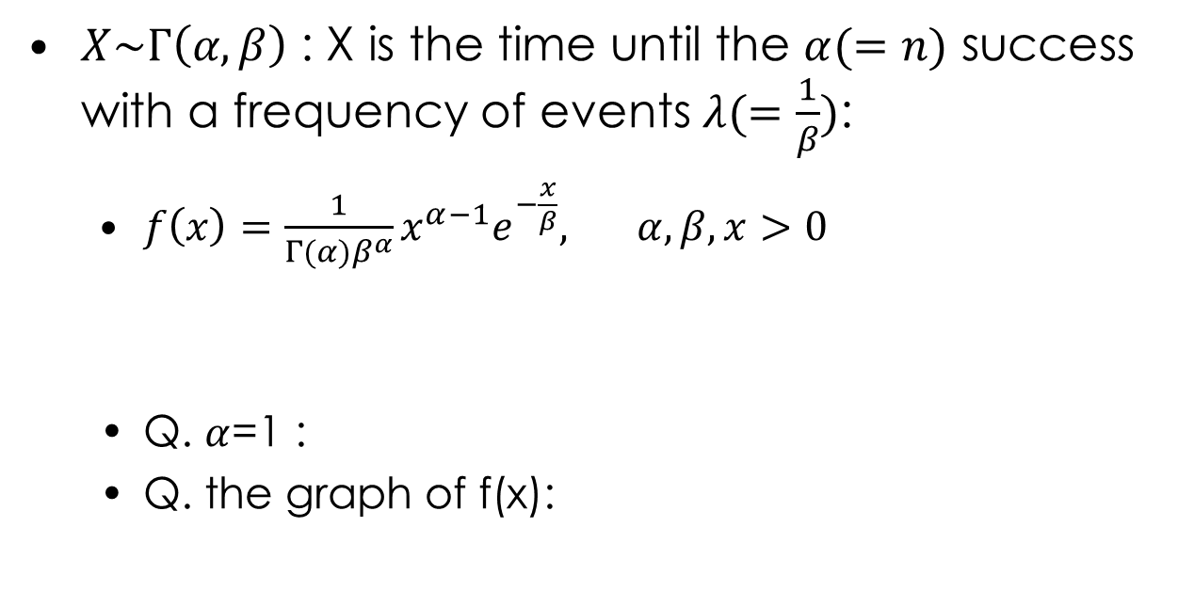
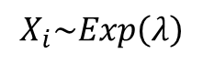
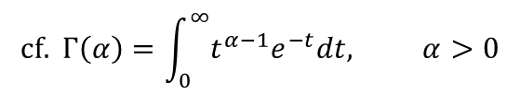
5.2 Gamma Distribution(감마분포)
$X\sim Γ\left(α,β\right)$ : X is the time until the $α(=n)$ success with a frequency of events $λ(=\frac{1}{β})$:
$f\left(x\right)=\frac{1}{Γ(α)β^{α}}x^{α−1}e^{−\frac{x}{β}}, α,β,x>0$
Q. $α$=1 :
Q. the graph of f(x):
$$X_{i}\sim Exp\left(λ\right)$$
$$cf. Γ\left(α\right)=\int_{0}^{∞}{t^{α−1}e^{−t}dt, α>0}$$
See Appendix A.4 for details.

Slide 11
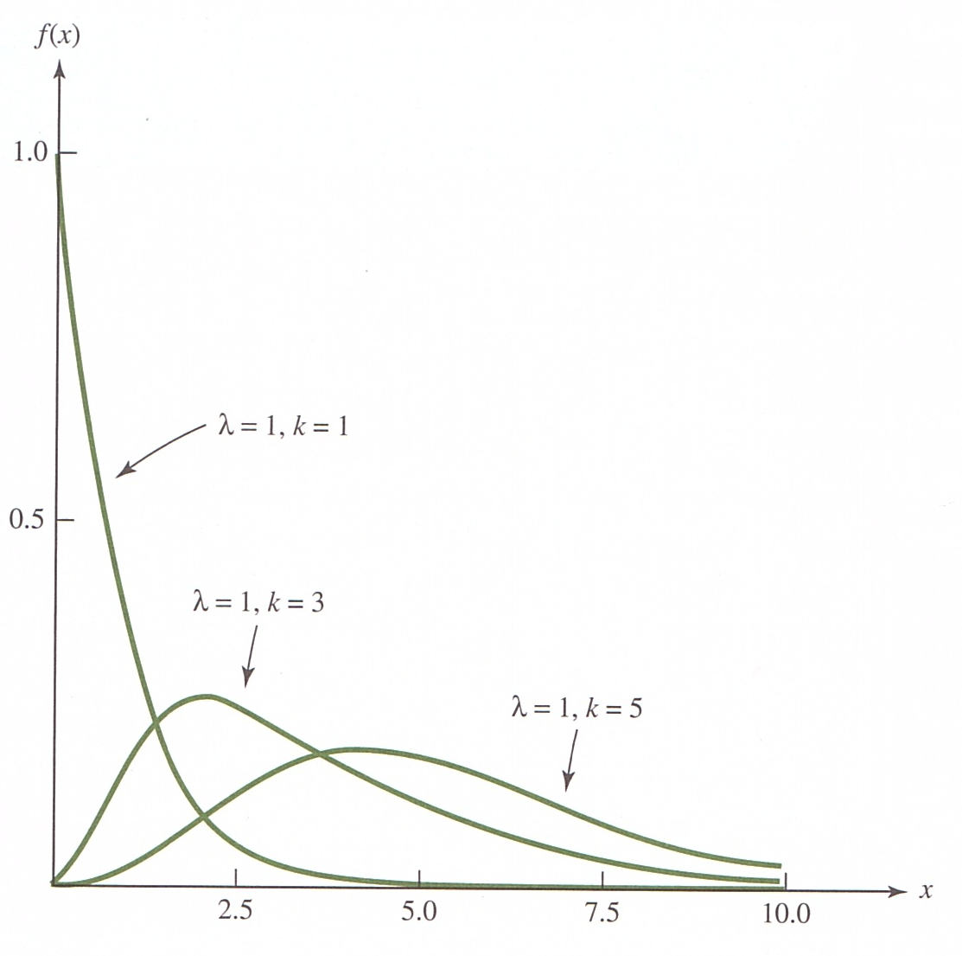
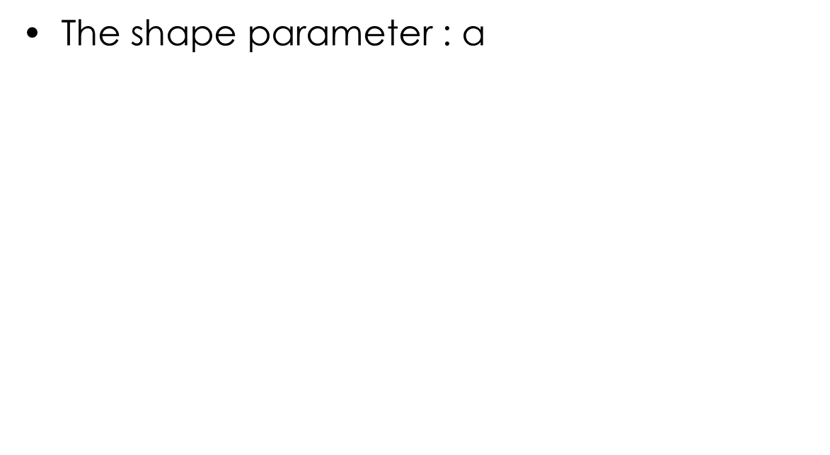
5.2 Gamma Distribution(감마분포)
The shape parameter : $\text{α}$
α=1, β=1
α=3, β=1
α=5, β=1

Slide 12
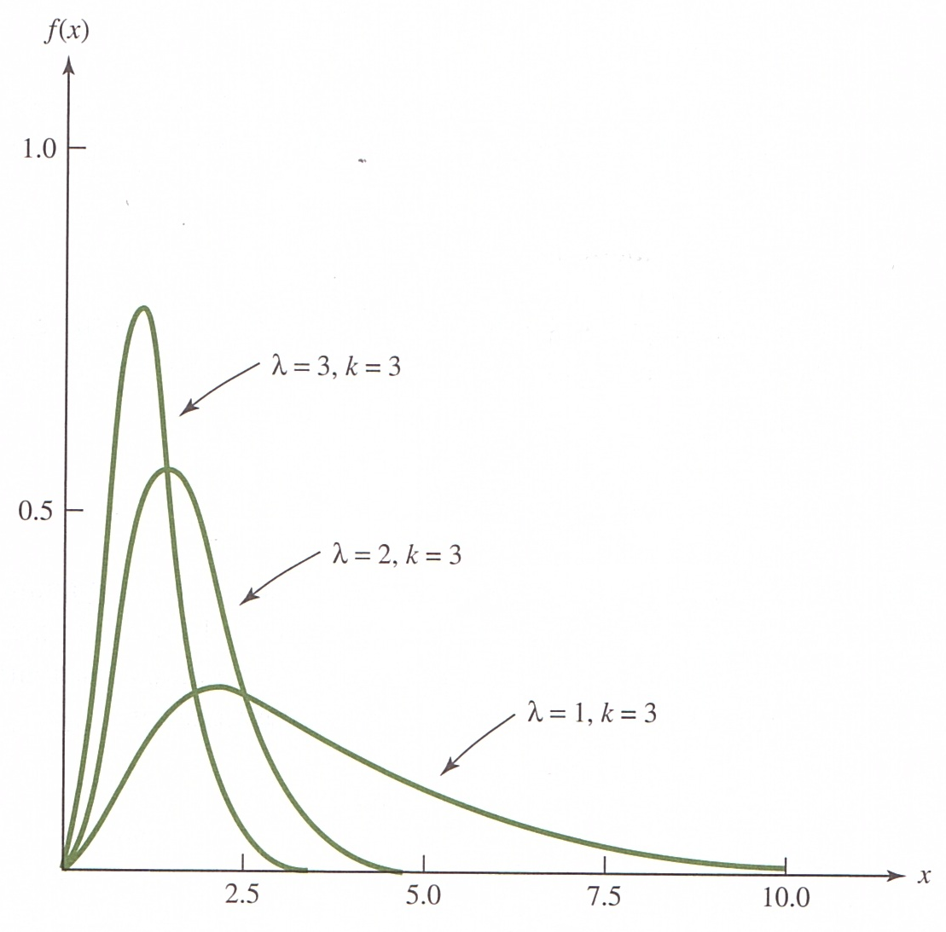
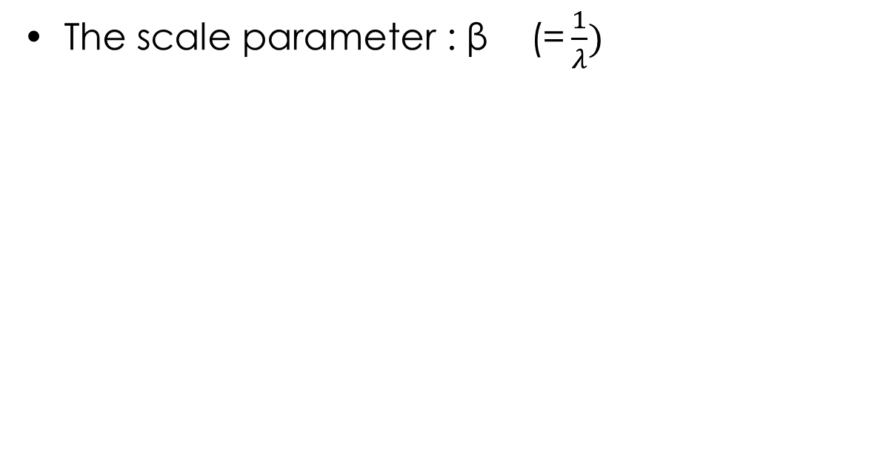
5.2 Gamma Distribution(감마분포)
The scale parameter : $\text{β}\text{ (=}\frac{1}{λ})$
α=3, β=1/3
α=3, β=1/2
α=3, β=1

Slide 13
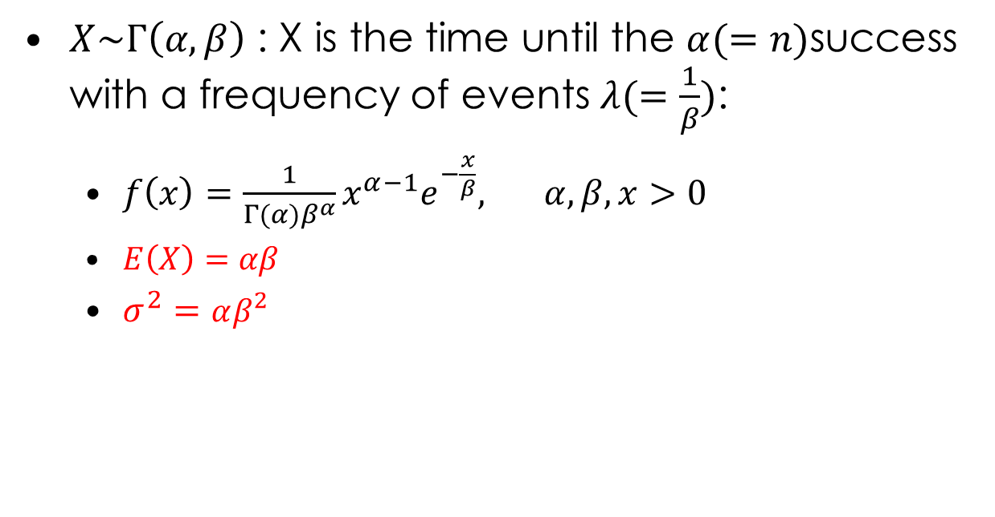
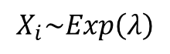
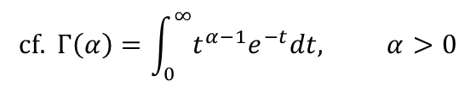
5.2 Gamma Distribution(감마분포)
$X\sim Γ\left(α,β\right)$ : X is the time until the $α(=n)$success with a frequency of events $λ(=\frac{1}{β})$:
$f\left(x\right)=\frac{1}{Γ(α)β^{α}}x^{α−1}e^{−\frac{x}{β}}, α,β,x>0$
$E\left(X\right)=αβ$
$σ^{2}=αβ^{2}$
$$cf. Γ\left(α\right)=\int_{0}^{∞}{t^{α−1}e^{−t}dt, α>0}$$
See Appendix A.4 for details.
$$X_{i}\sim Exp\left(λ\right)$$

Slide 14
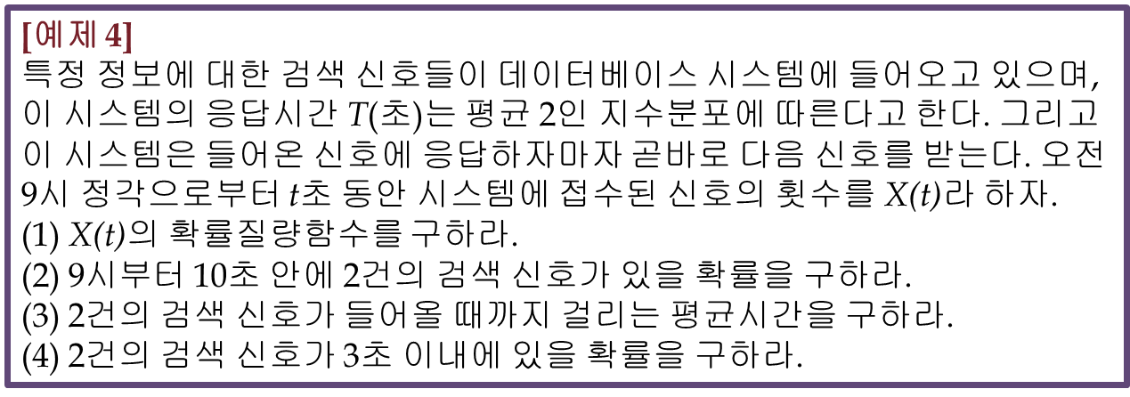
5.2 Gamma Distribution(지수분포)
Activity2(예제4):

Slide 15
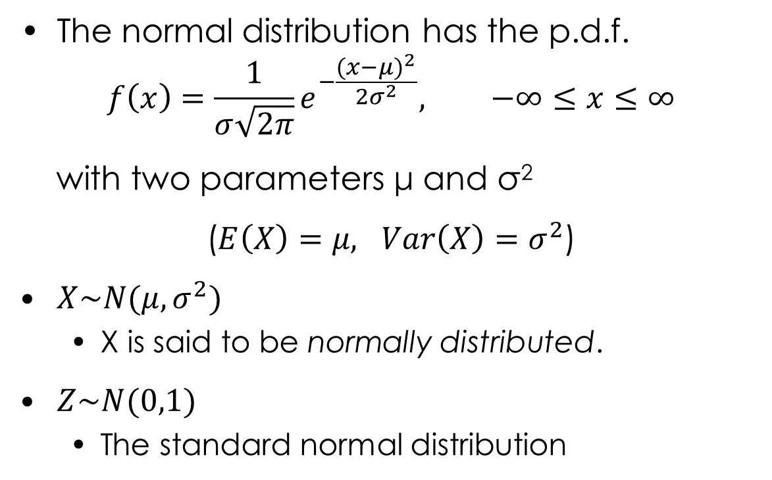
5.3 The Normal Distribution(정규분포)
The normal distribution has the p.d.f.
$$f\left(x\right)=\frac{1}{σ\sqrt{2π}}e^{−\frac{{(x−μ)}^{2}}{2σ^{2}}}, −∞≤x≤∞$$
with two parameters μ and σ²
($E\left(X\right)=μ, Var\left(X\right)=σ^{2}$)
$X\sim N(μ,σ^{2})$
X is said to be normally distributed.
$Z\sim N(0,1)$
The standard normal distribution

Slide 16
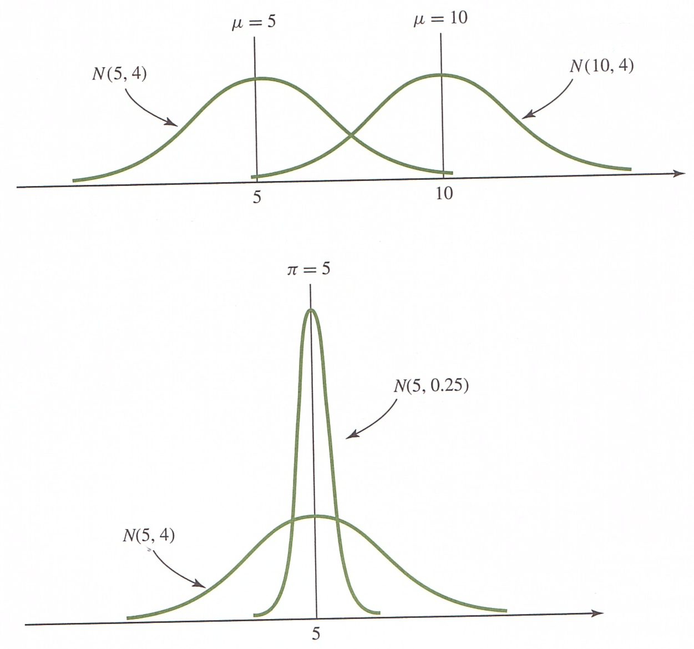
5.3 The Normal Distribution(정규분포)

Slide 17
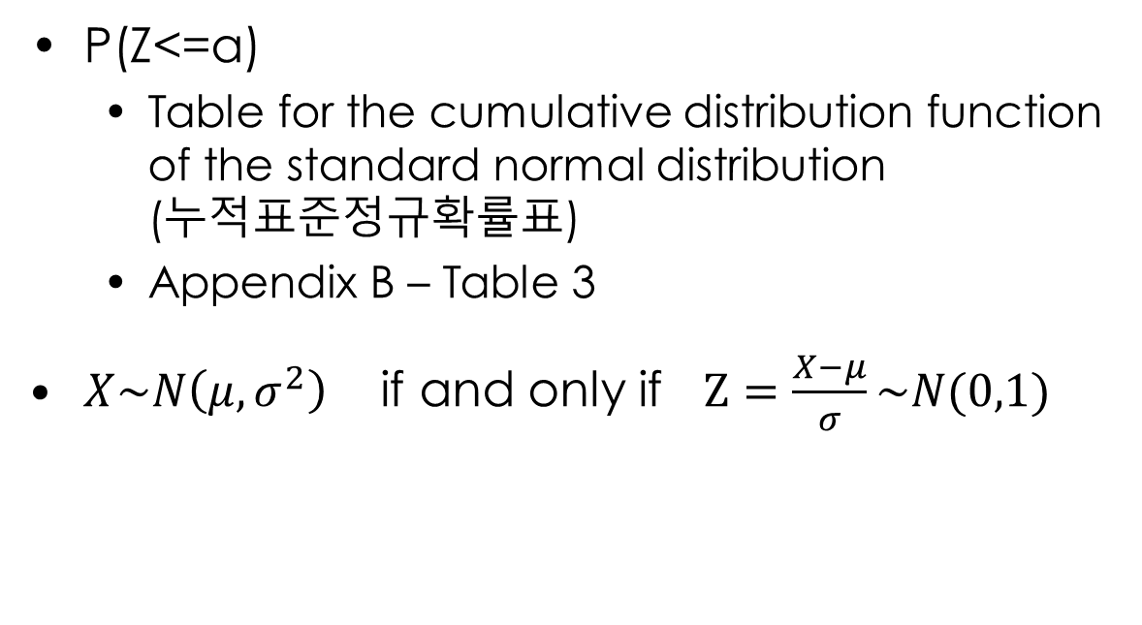
5.3 The Normal Distribution(정규분포)
P(Z<=a)
Table for the cumulative distribution function of the standard normal distribution (누적표준정규확률표)
Appendix B – Table 3
$X\sim N\left(μ,σ^{2}\right)$ if and only if $Z=\frac{X−μ}{σ}\sim N(0,1)$

Slide 18
5.3 The Normal Distribution(정규분포)
Activity1
P(Z<=1.5), P(Z<=0.5), P(Z<=1)
(예제2)

Slide 19

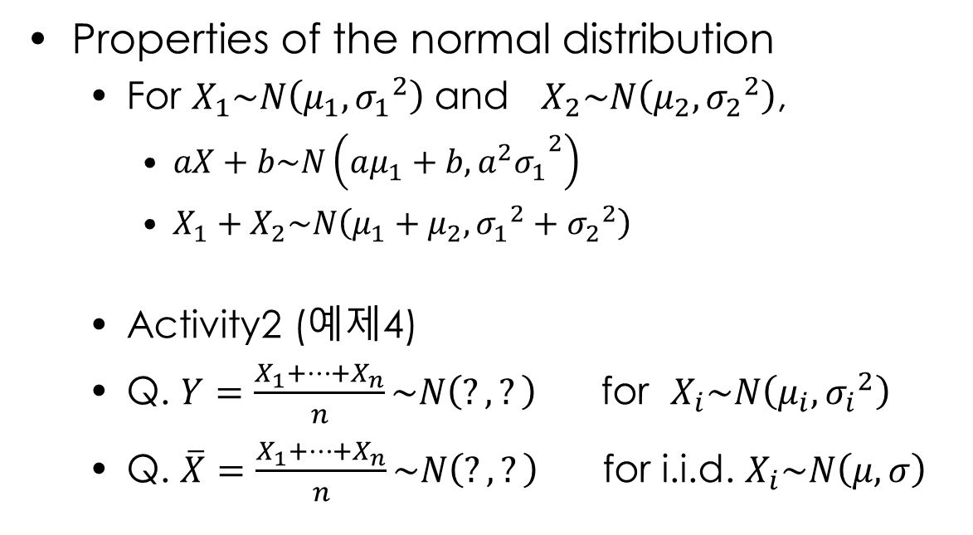
5.3 The Normal Distribution(정규분포)
Properties of the normal distribution
For $X_{1}\sim N\left(μ_{1},{σ_{1}}^{2}\right)$ and $X_{2}\sim N\left(μ_{2},{σ_{2}}^{2}\right)$,
$aX+b\sim N\left(aμ_{1}+b,{a^{2}σ_{1}}^{2}\right)$
$X_{1}+X_{2}\sim N\left(μ_{1}+μ_{2},{σ_{1}}^{2}+{σ_{2}}^{2}\right)$
Activity2 (예제4)
Q. $Y=\frac{X_{1}+…+X_{n}}{n}\sim N\left(?,?\right)$ for $X_{i}\sim N\left(μ_{i},{σ_{i}}^{2}\right)$
Q. $\overline{X}=\frac{X_{1}+…+X_{n}}{n}\sim N\left(?,?\right)$ for i.i.d. $X_{i}\sim N\left(μ,σ\right)$
(가$정: X_{i}$는 독립)
i.i.d. (independent identically distributed) random variables

Slide 20
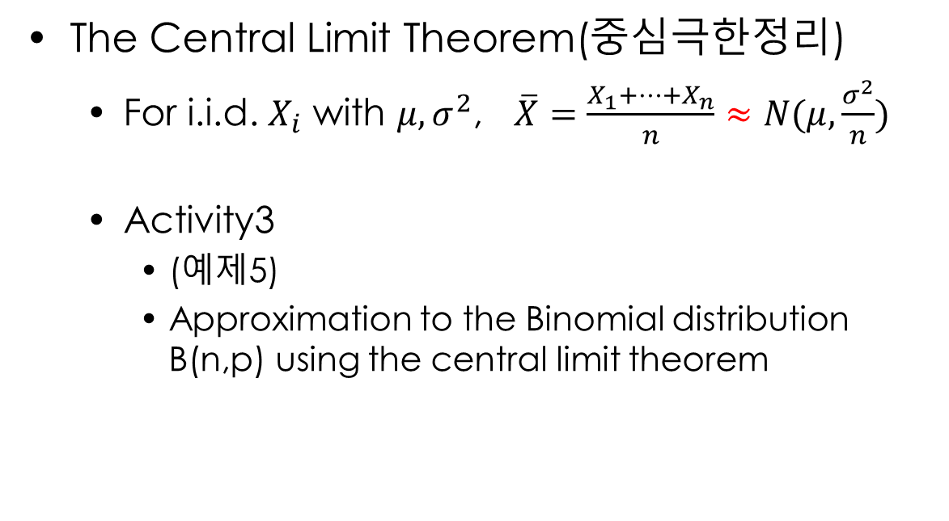
5.3 The Normal Distribution(정규분포)
The Central Limit Theorem(중심극한정리)
For i.i.d. $X_{i}$ with $μ, σ^{2}$, $\overline{X}=\frac{X_{1}+…+X_{n}}{n}≈N(μ,\frac{σ^{2}}{n})$
Activity3
(예제5)
Approximation to the Binomial distribution B(n,p) using the central limit theorem
i.i.d. (independent identically distributed)

Slide 21
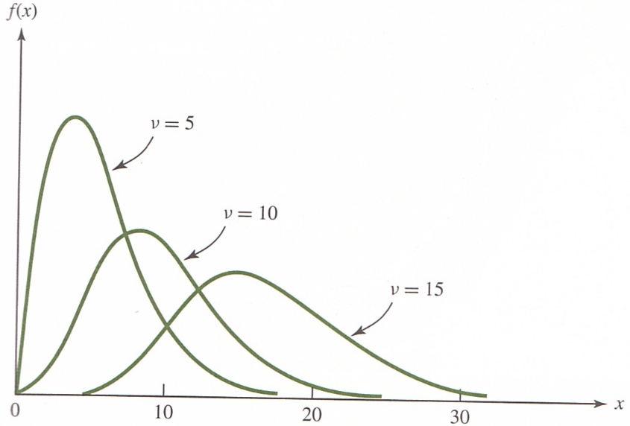
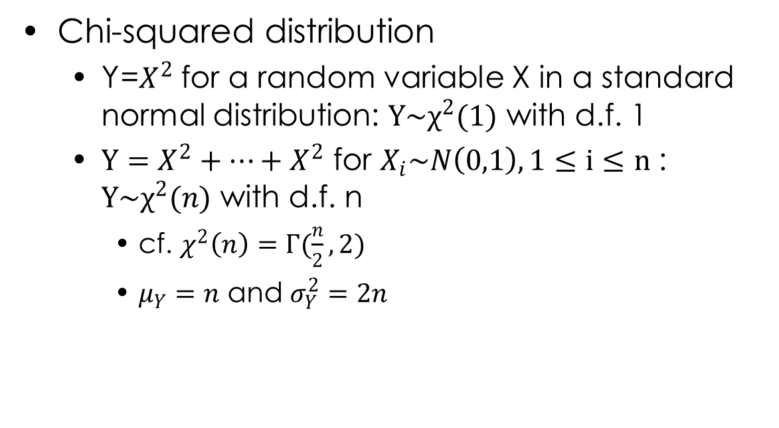
5.4 Chi-Squared Distribution(카이제곱분포)
d.f. : degree of freedom
Chi-squared distribution
Y=$X^{2}$ for a random variable X in a standard normal distribution: $Y\sim χ^{2}(1)$ with d.f. 1
$Y=X^{2}+…+X^{2}$ for $X_{i}\sim N\left(0,1\right), 1≤i≤n$ : $Y\sim χ^{2}(n)$ with d.f. n
cf. $χ^{2}\left(n\right)=Γ(\frac{n}{2},2)$
$μ_{Y}=n$ and $σ_{Y}^{2}=2n$

Slide 22
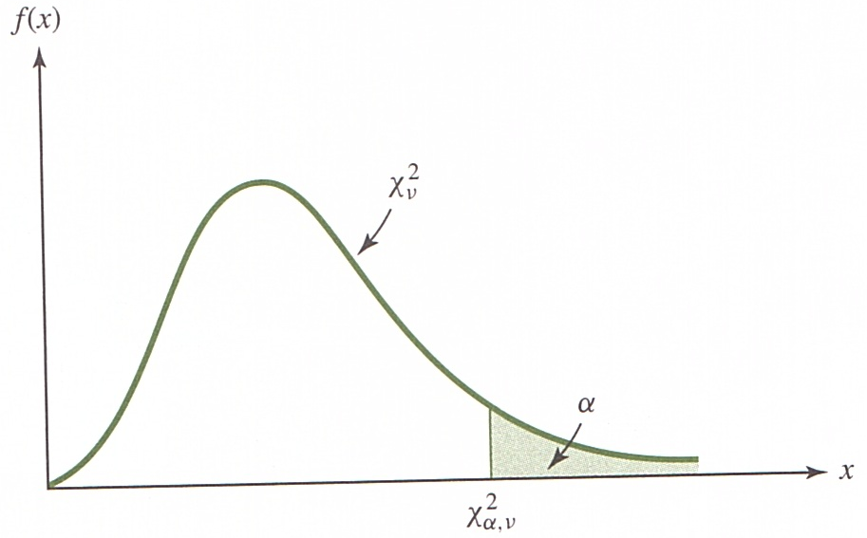
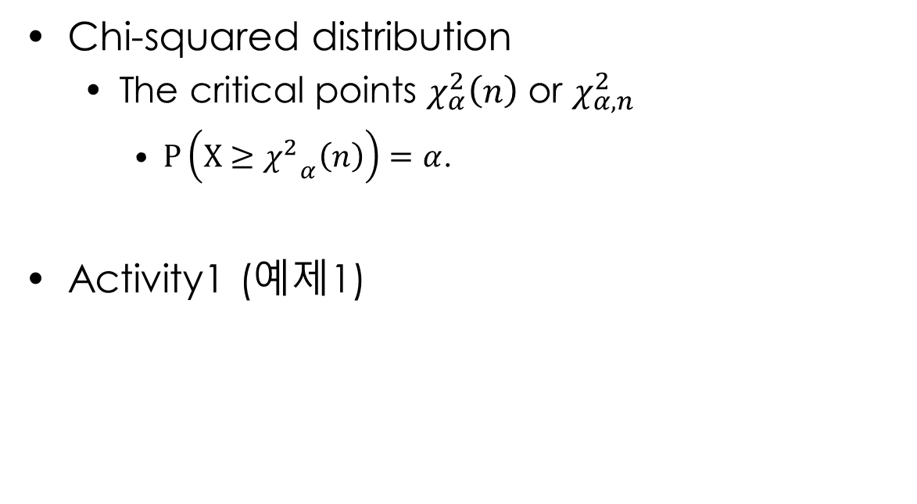
5.4 Chi-Squared Distribution(카이제곱분포)
Chi-squared distribution
The critical points $χ_{α}^{2}\left(n\right)$ or $χ_{α,n}^{2}$
$P\left(X≥{χ^{2}}_{α}\left(n\right)\right)=α$.
Activity1 (예제1)

Slide 23
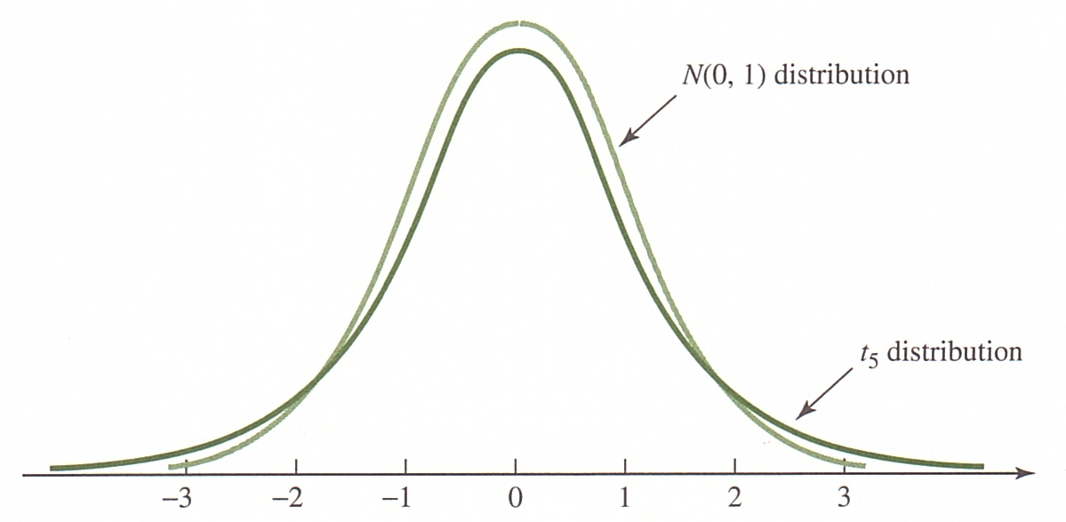
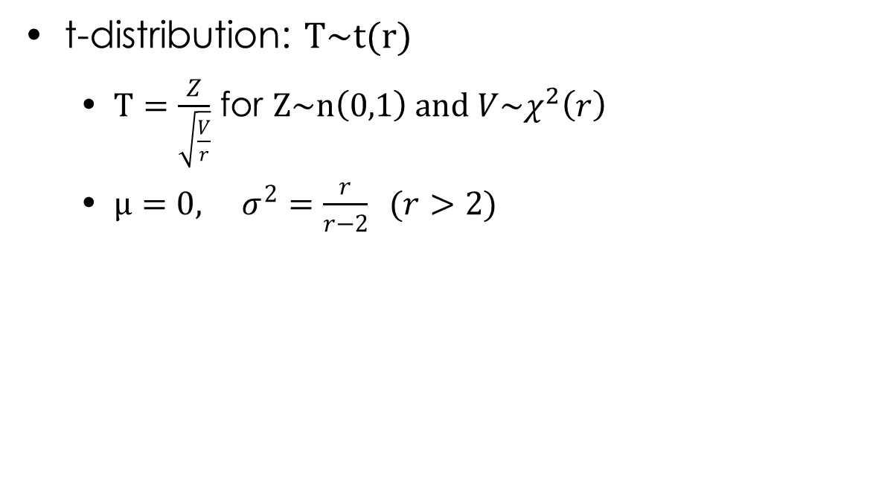
5.4 t-distribution(t 분포)
t-distribution: $T\sim t(r)$
$T=\frac{Z}{\sqrt{\frac{V}{r}}}$ for $Z\sim n\left(0,1\right) and V\sim χ^{2}\left(r\right)$
$μ=0, σ^{2}=\frac{r}{r−2} (r>2)$
(Z and V are independent)

Slide 24
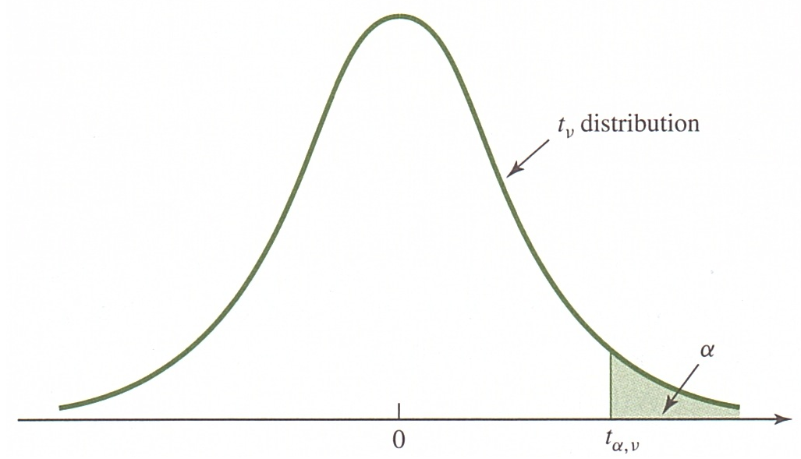
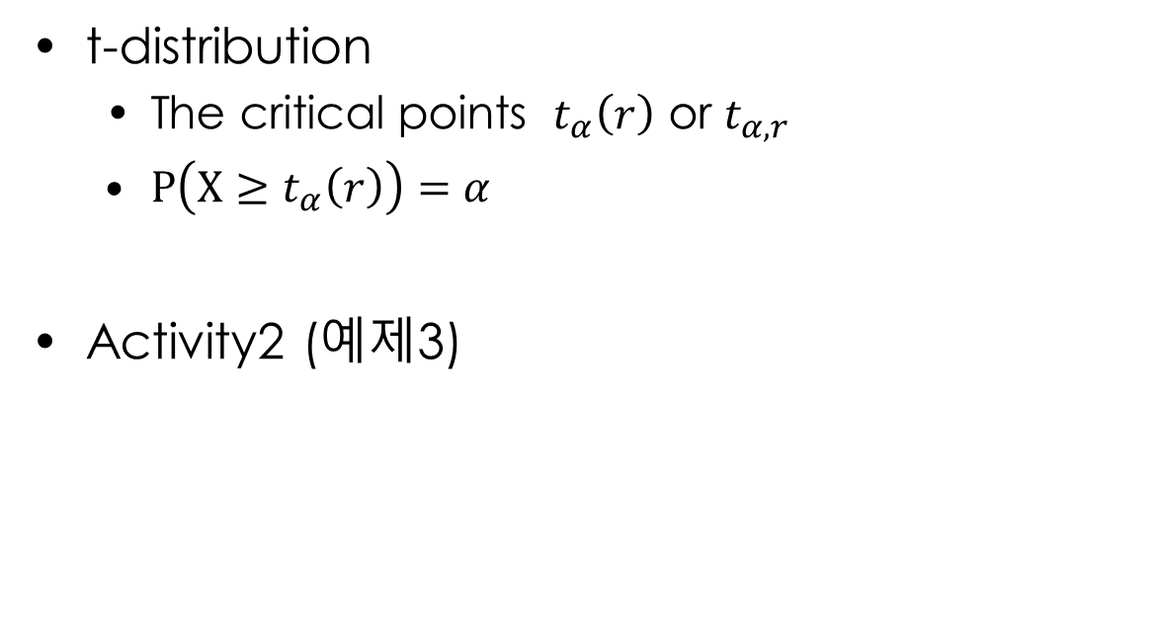
5.4 t-distribution(t 분포)
t-distribution
The critical points $t_{α}\left(r\right)$ or $t_{α,r}$
$P\left(X≥t_{α}\left(r\right)\right)=α$
Activity2 (예제3)

Slide 25
5.4 t-distribution(t 분포)
William Sealey Gosset (1876-1937) studied mathematics and chemistry at Oxford University in England. In 1899 he moved to Dublin, Ireland, and worked as a statistician for the Guinness brewery. During his work on the quality of barley and hops, Gosset proposed the use of the t-distribution, and in 1908 he published his ideas in an academic article using the pseudonym “Student” because Guinness forbade its employees from publishing their own research results. Consequently, the t-distribution is often referred to as Student’s t-distribution.
https://ko.wikipedia.org/wiki/윌리엄_고셋
https://ko.wikipedia.org/wiki/스튜던트_t_분포
The probable error of a mean, http://www.york.ac.uk/depts/maths/histstat/student.pdf

Slide 26
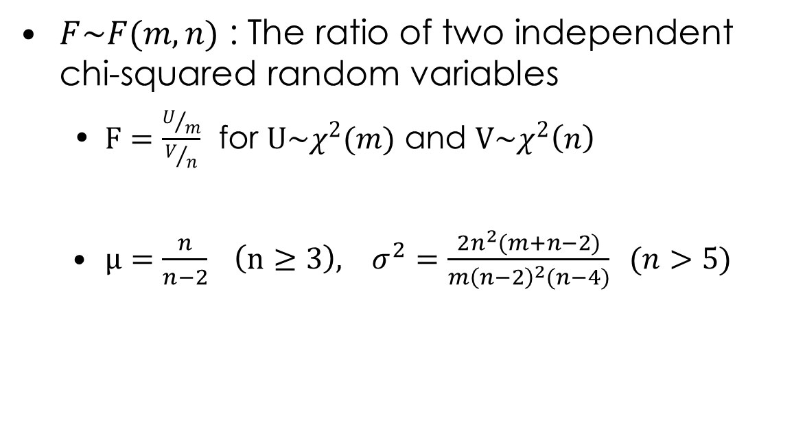
5.4 F-distribution(F 분포)
$F\sim F(m,n)$ : The ratio of two independent chi-squared random variables
$F=\frac{U/m}{V/n}$ for $U\sim χ^{2}(m)$ and $V\sim χ^{2}\left(n\right)$
$μ=\frac{n}{n−2} \left(n≥3\right), σ^{2}=\frac{2n^{2}(m+n−2)}{m{\left(n−2\right)}^{2}(n−4)} (n>5)$
(U and V are independent)

Slide 27
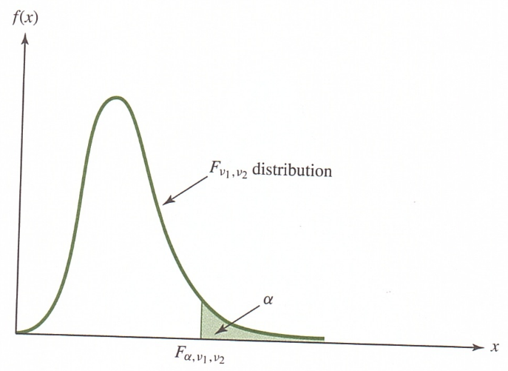
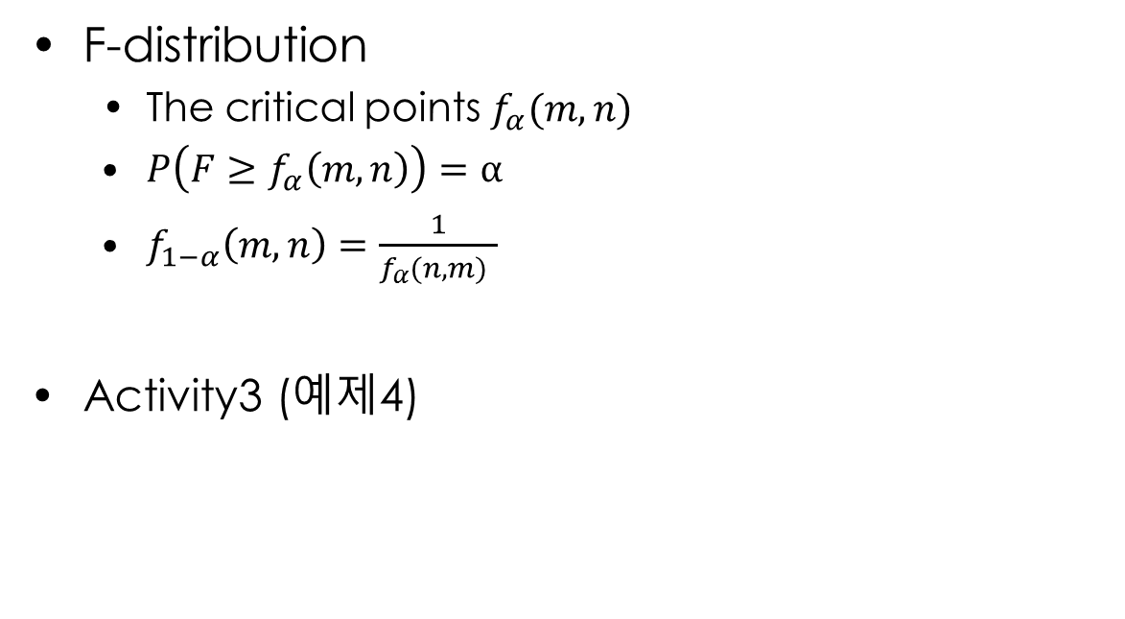
5.4 F-distribution(F 분포)
F-distribution
The critical points $f_{α}(m,n)$
$P\left(F≥f_{α}\left(m,n\right)\right)=α$
$f_{1−α}\left(m,n\right)=\frac{1}{f_{α}(n,m) }$
Activity3 (예제4)

Slide 28
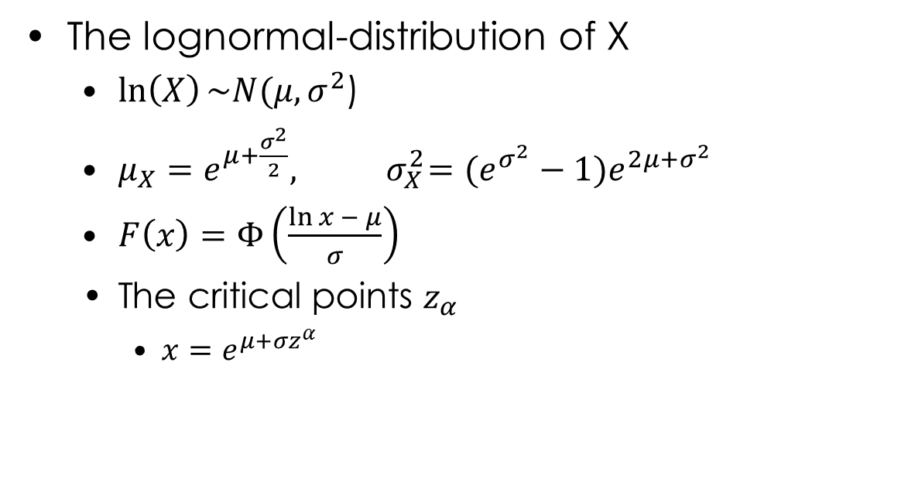
5.4 Lognormal-distribution(로그정규분포)
The lognormal-distribution of X
$\ln\left(X\right)\sim N(μ,σ^{2}$)
$μ_{X}=e^{μ+\frac{σ^{2}}{2}},{ σ}_{X}^{2}=(e^{σ^{2}}−1)e^{2μ+σ^{2}}$
$F\left(x\right)=Φ\left(\frac{\ln{x − μ}}{σ}\right)$
The critical points $z_{α}$
$x=e^{μ+σz^{α}}$

Slide 29
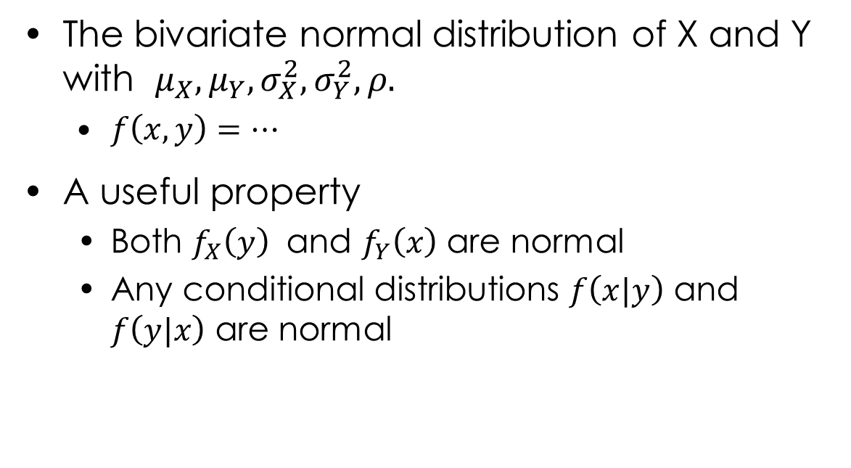
5.4 Bivariate normal distribution (이변량정규분포)
The bivariate normal distribution of X and Y with $μ_{X}, μ_{Y},σ_{X}^{2},σ_{Y}^{2},ρ.$
$f\left(x,y\right)=…$
A useful property
Both $f_{X}\left(y\right)$ and $f_{Y}\left(x\right)$ are normal
Any conditional distributions $f\left(x|y\right)$ and $f\left(y|x\right)$ are normal

Slide 30
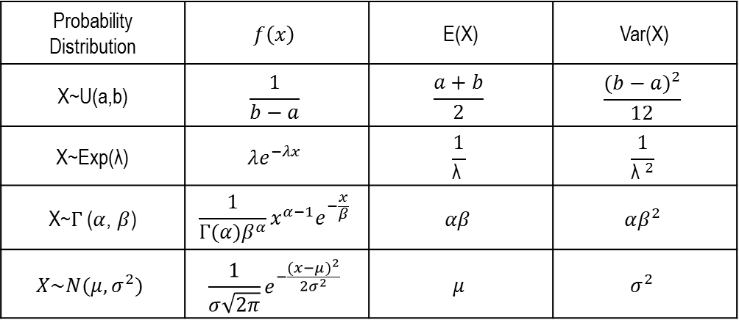
What we have learned
A series of useful continuous probability distributions
Probability Distribution | $$f\left(x\right)$$ | E(X) | Var(X)
X~U(a,b) | $$\frac{1}{b−a}$$ | $$\frac{a+b}{2}$$ | $$\frac{{(b−a)}^{2}}{12}$$
X~Exp($\text{λ}$) | $$λe^{−λx}$$ | $$\frac{1}{\text{λ} }$$ | $$\frac{1}{{\text{λ} }^{2}}$$
X~$Γ$($α$, $β$) | $$\frac{1}{Γ(α)β^{α}}x^{α−1}e^{−\frac{x}{β}}$$ | $$αβ$$ | $$αβ^{2}$$
$$X\sim N(μ,σ^{2})$$ | $$\frac{1}{σ\sqrt{2π}}e^{−\frac{{(x−μ)}^{2}}{2σ^{2}}}$$ | $$μ$$ | $$σ^{2}$$

